Slide 1

Design Masterclass Group 1
Design Masterclass.
Ubisoft.
Samuel Cook: Game Design & Art.
William Terry: Programming.

Slide 2

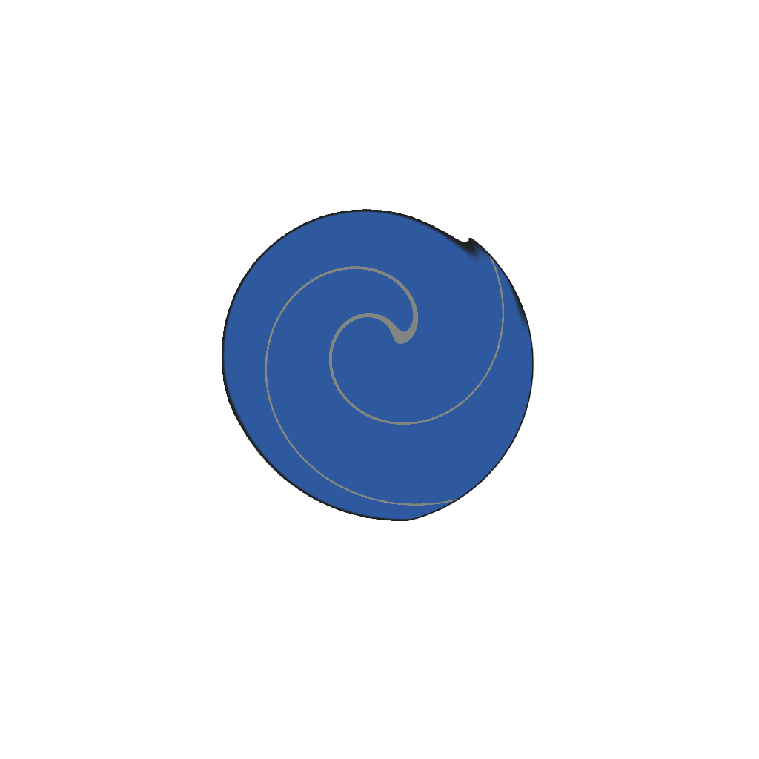

Player Actions.
Boosters can be placed in the game to speed up projectiles that fly through them.
Forcefields can be placed to block enemy projectiles reflecting them back the direction they came.
Singularities can be placed to block enemy asteroids and cause them to spin away randomly.

Slide 3
Component Breakdown
Boosters can be placed in the game to speed up projectiles that fly through them.
Forcefields can be placed to block enemy projectiles reflecting them back the direction they came.
Singularities can be placed to block enemy asteroids and cause them to spin away randomly.

Slide 4
Design Deviations

Slide 5
Play Testing.

Slide 6
Questions?

